Slide 1


2022 California
Housing Forecast
Bridge Association of REALTORS®
February 23, 2022
Jordan G. Levine
VP & Chief Economist
California Association of REALTORS®

Slide 2
Tempered optimism amidst increasing headwinds
01
02
Lots to be optimistic about
More normalization of demand
Economy improving and COVID declining
Market holding up relatively well in 2022
5 W’s of housing demand returning to trend
But, acceleration of structural change as well
03
04
Many headwinds brewing
What does it all mean?
Biggest challenge remains supply: new + existing
Inflation, rates, affordability, & industry stuff
Working super hard on the buy side with low supply
Also, more work to find and motivate new listings

Slide 3
Resort markets hit particularly hard by the lockdown

Slide 4
Broad-based jobs recovery thus far—even resort areas

Slide 5
California continues to make economic progress
~568K
~769K
2.7m

Slide 6
Bigger hole to climb out of…
but growing faster now

Slide 7
Renewed Passion
For Homeownership

Slide 8


First-time buyers still near decade-highs
1
SERIES: 2021 Housing Market Survey
SOURCE: CALIFORNIA ASSOCIATION OF REALTORS®

Slide 9

Share of 2nd/vacation home buying highest since 2012
SERIES: 2021 Housing Market Survey
SOURCE: CALIFORNIA ASSOCIATION OF REALTORS®
Notes:
9

Slide 10
Homeownership rate finally shows some progress

Slide 11
2021 was the best year for home sales in a decade

Slide 12
Locally, we were punching above our weight last year

Slide 13
Sales rise from year-end, despite increase in rates
California, January 2022 Sales: 444,540 Units, -8.3% YTD, -8.3% YTY, +3.4% MTM
SERIES: Sales of Existing Single Family Homes
SOURCE: CALIFORNIA ASSOCIATION OF REALTORS®
Notes:
*Sales are seasonally adjusted and annualized

Slide 14
Median home price rose to new record highs
SERIES: Median Price of Existing Single Family Homes
SOURCE: CALIFORNIA ASSOCIATION OF REALTORS®

Slide 15
Prices have risen substantially in Alameda County as well

Slide 16
Fierce competition, and not just on price
Contingencies Waived on Offer Accepted
 | $500k or below | $501k - $1M | Over $1M | All
Non-Contingent Offer | 55.6% | 61.4% | 64.7% | 60.5%
Appraisal | 35.4% | 53.7% | 60.4% | 49.8%
Property inspection | 23.5% | 28.3% | 41.3% | 29.9%
Financing | 19.3% | 24.7% | 46.5% | 28.7%
Selling of another house | 12.2% | 18.0% | 27.4% | 18.6%
Purchase of another house | 6.8% | 8.8% | 14.2% | 9.5%
Transfer disclosure statement post offer | 4.8% | 6.3% | 10.9% | 6.9%
SERIES: 2021 Housing Market Survey
SOURCE: CALIFORNIA ASSOCIATION OF REALTORS®
Notes:
Lowest weeks on MLS since 2013
Median price discount dipped
Biggest share of sales with sold price above asking price in 7 years

Slide 17
Local market even more competitive than rest of CA

Slide 18

More buyers paying all cash due to market competition
The share of all-cash buyers inched up in 2021 after it dipped to the lowest level since 2007 in the prior year. As competition remained intense in the market, more home buyers tried to stay on top of the heap by offering all cash. With interest rates remaining low by historical standards and home prices increasing by double-digits from a year earlier across the state, the share of all-cash sales remained the second lowest in the last 14 years, despite the slight bounce-back.
Market competitiveness varied between price segments. Properties in the mid-priced range — homes sold between $500,000 and $1 million — continued to be the most sought after, as they were the most likely to receive multiple offers, the most likely to receive an offer with a price at or above the asking price, and sold the fastest. While the mid-priced range was still the segment with the highest average number of offers this year, it was also the only price segment without any increase when compared to last year.
CALIFORNIA ASSOCIATION OF REALTORS®

Slide 19
Initial Signs of
Market Normalizing

Slide 20


Investor share bounced back last year
Rent
Flip
Vs.
2014: 30%
2015: 26%
2016: 20%
2017: 24%
2018: 26%
2019: 18%
2020: 27%
2021: 29%
2014: 70%
2015: 74%
2016: 80%
2017: 76%
2018: 74%
2019: 82%
2020: 73%
2021: 71%
SERIES: 2021 Housing Market Survey
SOURCE: CALIFORNIA ASSOCIATION OF REALTORS®
Notes:
20

Slide 21


International buyers bounced as well
SERIES: 2021 Housing Market Survey
SOURCE: CALIFORNIA ASSOCIATION OF REALTORS®

Slide 22
Size of home starting to normalize as well

Slide 23
Top-end of the market growth subsided
SERIES: Percent Change in Sales
SOURCE: CALIFORNIA ASSOCIATION OF REALTORS®

Slide 24
$1 million and up no longer widening the gap
COVID-19
Outbreak
SERIES: Sales by Price Range
SOURCE: CALIFORNIA ASSOCIATION OF REALTORS®

Slide 25
Core markets punching above their weight

Slide 26
Not just an artifact of the data—high levels of closed sales

Slide 27
Similar giveback in the local market after strong 2021

Slide 28
Supply Remains
THE Challenge

Slide 29
Active listings inched up only slightly from December

Slide 30
New listings continued to drop by double-digits
New Listings (Existing Single-Family Homes)
SERIES: New Listings (Existing Single-Family Homes)
SOURCE: CALIFORNIA ASSOCIATION OF REALTORS®

Slide 31
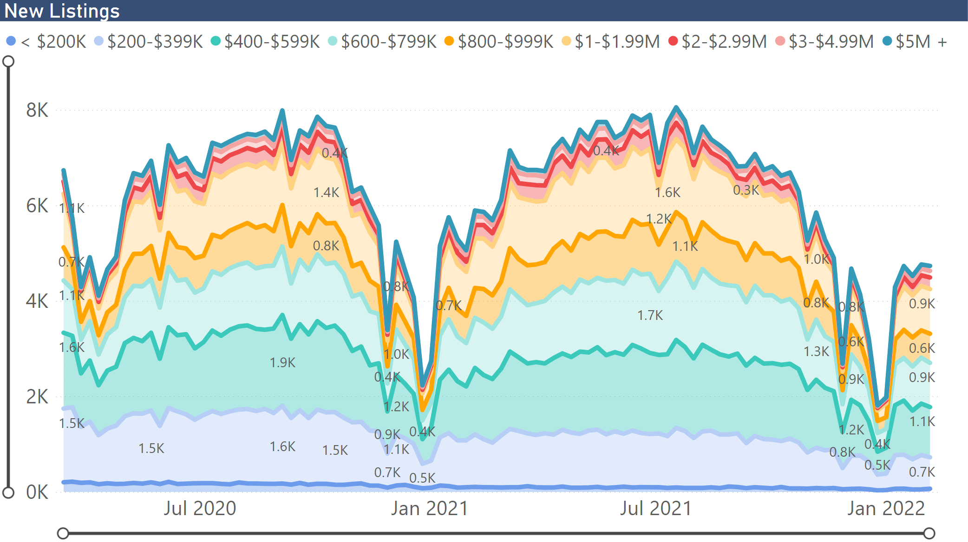
Especially units that regular people can actually afford

Slide 32
Homeownership opportunities hinge on adequate supply

Slide 33
Housing almost a pure auction mechanism

Slide 34
Housing almost a pure auction mechanism
Cut-off $529,903

Slide 35
Housing almost a pure auction mechanism

Slide 36
Prices still on the uptrend despite seasonal lull
California, January 2022: $765,580, -3.9% MTM, +9.4% YTY
SERIES: Median Price of Existing Single Family Homes
SOURCE: CALIFORNIA ASSOCIATION OF REALTORS®

Slide 37
Vast majority of California less affordable than elsewhere
2021-Q4: % able to purchase median-priced home
SERIES: Housing Affordability Index of Traditional Buyers
SOURCE: CALIFORNIA ASSOCIATION OF REALTORS®

Slide 38
Other Challenges
For Homebuyers

Slide 39
Inflation is rearing its ugly head again…

Slide 40
Rates have been rising in response recently

Slide 41
But even small changes in rates have a big impact

Slide 42
Rising rates compounds the effect of rising prices
SERIES: Price Growth vs. Mortgage Payment Growth
SOURCE: CALIFORNIA ASSOCIATION OF REALTORS®

Slide 43
Is it a good time to buy or sell?
Do you think it’s a good time to buy a home in California?
Do you think it’s a good time to sell a home in California?
SERIES: Google Consumer Poll
SOURCE: CALIFORNIA ASSOCIATION OF REALTORS®
Notes:
%yes
September 2018-January 2020 n=300
February 2020 and beyond n=1,000
Feb-21 n=947

Slide 44
But… there’s a demand component there as well

Slide 45
Pending sales continue to decline by double-digits
SERIES: Percent Change in Pending Sales
SOURCE: CALIFORNIA ASSOCIATION OF REALTORS®

Slide 46
Market getting slightly less competitive
California, January 2021: 11.0 Days; January 2022:12.0 Days
SERIES: Median Time of Market of Existing Single Family Homes
SOURCE: CALIFORNIA ASSOCIATION OF REALTORS®

Slide 47
Share of homes sold above asking price dipped below 60% for the third consecutive month
SERIES: Sales with sold price above asking price (Existing SFH)
SOURCE: CALIFORNIA ASSOCIATION OF REALTORS®

Slide 48
Don’t
Panic

Slide 49
And… demand is still robust by pre-crisis standards

Slide 50
COVID numbers finally coming down for spring lull

Slide 51
Still a tailwind for demand w/rates near historic lows

Slide 52
We need to keep buyers’ eyes on the prize
Q. What was the net cash gain or net loss to the seller as a result of this sale?
SERIES: 2021 Housing Market Survey
SOURCE: CALIFORNIA ASSOCIATION OF REALTORS®

Slide 53
U.S. economic outlook
 | 2016 | 2017 | 2018 | 2019 | 2020 | 2021p | 2022f
US GDP | 1.6% | 2.3% | 3.0% | 2.2% | -3.5% | 5.7% | 3.8%
Nonfarm Job Growth | 1.8% | 1.6% | 1.6% | 1.3% | -5.7% | 3.7% | 2.8%
Unemployment | 4.9% | 4.4% | 3.9% | 3.7% | 8.1% | 5.4% | 3.8%
CPI | 1.4% | 2.1% | 2.4% | 1.8% | 1.2% | 4.7% | 4.3%
Real Disposable Income, % Change | 2.7% | 2.9% | 4.0% | 2.9% | 5.8% | 2.1% | -3.1%

Slide 54
California economic outlook
 | 2016 | 2017 | 2018 | 2019 | 2020 | 2021p | 2022f
Nonfarm Job Growth | 2.3% | 2.1% | 2.1% | 1.5% | -6.9% | 2.0% | 4.0%
Unemployment | 5.5% | 4.8% | 4.3% | 4.1% | 10.3% | 7.8% | 5.9%
CA Population (Million) | 39.4 | 39.5 | 39.6 | 39.6 | 39.5 | 39.5 | 39.5
Population Growth | 0.6% | 0.4% | 0.2% | 0.1% | -0.5% | 0.0% | 0.1%
SERIES: U.S. Economic Outlook
SOURCE: CALIFORNIA ASSOCIATION OF REALTORS®

Slide 55
California housing market outlook
 | 2015 | 2016 | 2017 | 2018 | 2019 | 2020 | 2021p | 2022f
SFH Resales (000s) | 409.4 | 417.7 | 424.9 | 402.6 | 398.0 | 411.9 | 444.5 | 421.5
% Change | 7.0% | 2.0% | 1.7% | -5.2% | -1.2% | 3.5% | 7.9% | -5.2%
Median Price ($000s) | $476.3 | $502.3 | $537.9 | $569.5 | $592.4 | $659.4 | $786.8 | $827.7
% Change | 6.6% | 5.4% | 7.1% | 5.9% | 4.0% | 11.3% | 19.3% | 5.2%
Housing Affordability Index | 31% | 31% | 29% | 28% | 31% | 32% | 26% | 23%
30-Yr FRM | 3.9% | 3.6% | 4.0% | 4.5% | 3.9% | 3.1% | 3.0% | 3.8%
page
55
SERIES: CA Housing Market Outlook
SOURCE: CALIFORNIA ASSOCIATION OF REALTORS®

Slide 56
Thank You
This presentation can be found on
www.car.org/marketdata
Speeches & Presentations
jordanl@car.org

